Slide 1



Advanced DCOI Wood Preservative

Slide 2


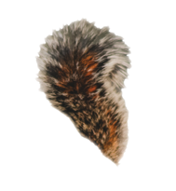
The Effective and Popular Pentachlorophenol (or penta) will Cease to be Manufactured December 2021
On March 10, 2020 Gulbrandsen decided not to produce penta.
This leaves no one willing or able to produce penta.
Penta poles will still be available for a while after this date.
So, what are the alternatives?

Slide 3
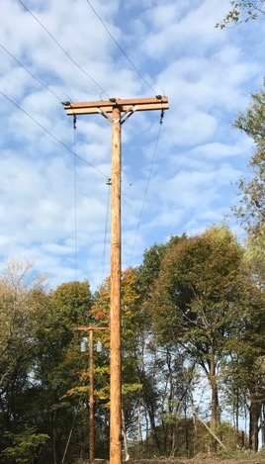

Options After Penta
ACZA – Ammoniacal Copper Zinc Arsenate
  Waterborne
  Used primarily with Douglas fir in aquatic situations
CCA – Chromated Copper Arsenate
  Waterborne
  Used in Southern Yellow Pine (SYP) poles primarily in the southeast
  Used in aquatic situations
Creosote
  Used in Southern Yellow Pine (SYP) poles and Douglas fir
  Used in Aquatic situations
CuNap - Copper Naphthenate
  Oil borne can be used for Douglas fir and SYP
DCOI - 4,5-Dichloro-2-n-Octyl-4-Isothiazolin-3-One
  Oil borne can be used for Douglas fir and SYP

Slide 4
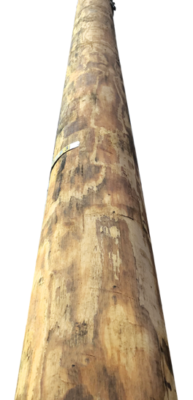


What is the Industry’s Best Option?
The DCOI treated UltraPole offers the treater, utility and consumer, a warranted, environmentally advanced and tested system for protecting the wood support structures that bring power to homes
and businesses.

Slide 5

What is DCOI?
It is an organic wood preservative.
It is a broad-spectrum antimicrobial compound.
It is an AWPA standardized wood preservative listed as P-39 in the AWPA Book of Standards.
DCOI is the first new oil borne industrial wood preservative in decades.

Slide 6
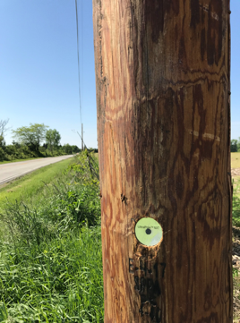
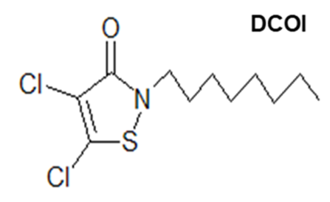
DCOI-what is it?
4,5-Dichloro-2-n-Octyl-4-Isothiazolin-3-One

Slide 7
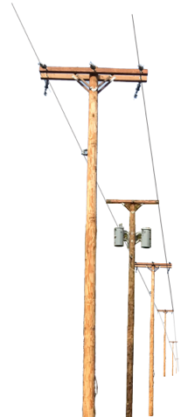
How Does DCOI Compare to Penta?
A DCOI treated UltraPole® NXT pole looks just like a penta treated pole.
Both preservatives use similar if not identical oil solvents as a carrier.
DCOI poles are easy to climb just like other oil-borne treated poles.
Conductivity, or more accurately, electrical resistance, is comparable to penta poles.
Hardware corrosion rate for UltraPole NXT poles is similar to penta poles.
It is an effective wood preservative like penta – at 1/3 or less retention.
DCOI can be disposed of like other poles – in landfills.
All treated wood poles have a superior life cycle environmental profile than competing materials such as steel, iron, concrete, and fiberglass.

Slide 8





Effective and Unique
DCOI is an industrial microbicide used in brewery pasteurizing and can warmer systems.
DCOI is a moldicide used in paints and coatings.
DCOI is an algaecide used in cooling towers.

Slide 9
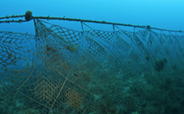




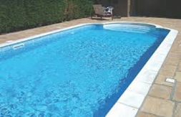


Effective and Unique
In fish nets, treated wood decks and hulls of ocean-going vessels
DCOI is in drywall, shower curtains and pool liners.

Slide 10

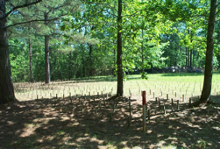
Effective
DCOI is the active ingredient in marine antifouling formulations that won the 1996 US EPA Presidential Green Chemistry Challenge Award.
Decades of stake test data commissioned by Electric Power Research Institute (EPRI) and monitored by Mississippi State University (MSU) indicate it performs well in the challenging environments in sub-tropical plots in Dorman Lake MS and Saucier MS, proving its efficacy as a fungicide and insecticide.

Slide 11
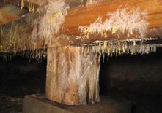
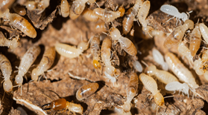
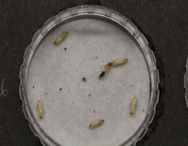
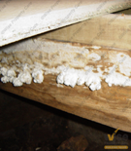
DCOI Performance
Laboratory and long-term field testing has demonstrated that UltraPole NXT treated wood is highly effective against decay fungi and termites.
Minimum retention recommendations of 0.04 pcf for above ground and 0.08 pcf for ground contact were established by AWPA in 1989.
This test data used by AWPA to adopt the retentions for poles and cross arms are inherently conservative and provide a significant performance safety factor .
AWPA is the largest collection of wood preservation experts in the world.

Slide 12
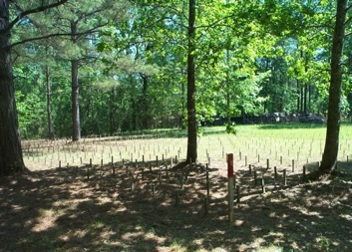
United States Department of Agriculture - Forest Service Forest Products Laboratory Research Note FPL–RN–02
Comparison of Wood Preservatives in Stake Tests - 2011 Progress Report
Bessie M. Woodward - Cherilyn A. Hatfield - Stan T. Lebow
Table 77--Summary of 2- by 4-in. stake (pages 117-120)
Type III (CCA-C) (Fed. Spec. TT-W-550)
0.40 pcf - No failures after 40 years
Pentachlorophenol in P9 (HSA)
0.29 pcf - No failures after 38-1/2 years
Not in USDA FPL test but in adjacent test plots - DCOI (EPRI initiated study with MSU)
Data presented to AWPA - 28 years
As effective at 1/3 the retention of penta

Slide 13
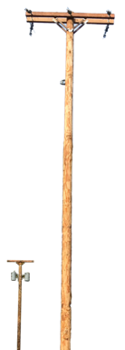
Environmental Impact
DCOI is a metal free preservative - no zinc, copper, arsenic, or chrome.
Lower retention (1/3 of penta) equates to less chemicals overall in the environment.
The active ingredient, DCOI, used in UltraPole NXT poles is also used for residential treated wood. Ecolife® is the leading non-metal based residential treated wood used in backyard decks and other residential projects.
End of life use as a co-gen fuel offers an alternative to increasingly regulated and expensive land fill costs.
A description of material characterization of DCOI has been submitted to EPA for the approval of DCOI treated wood as a co-gen fuel.
DCOI is not a restricted use pesticide.

Slide 14
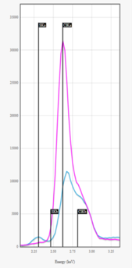

DCOI in Oil - End of Life Disposal
Controlled laboratory combustion studies have shown that no harmful products such as polychlorinated dibenzo p-dioxins, p-furans or polychlorinated biphenyls are formed when DCOI treated wood is burned under normal co-gen operating conditions
Based on that data end-of life disposal of Ultrapole NXT poles though co-gen facilities may be possible and is likely
New technology allows for a quick determination of treated wood preservative
Hitachi is working with Viance to fine tune Hitachi’s hand held device
EPA approval to burn treated wood as non hazardous secondary waste in co-gen facilities is a complex and time consuming process. Currently we are working with a consultant familiar with EPA’s RCRA Division – Office of Solid Waste to expedite the necessary approvals

Slide 15
AWPA Standards
U1 Standards | UC4A | UC4B | UC4C
Southern Yellow Pine Penta | 0.30 pcf | 0.38 pcf | 0.45 pcf
Southern Yellow Pine DCOI | 0.10 pcf | 0.13 pcf | 0.15 pcf
Douglas fir Penta | 0.45 pcf | 0.45 pcf | 0.60 pcf
Douglas fir DCOI | 0.15 pcf | 0.15 pcf | 0.20 pcf
Red Pine Penta | 0.50 pcf | 0.50 pcf | 0.60 pcf
Red Pine DCOI | 0.17 pcf | 0.17 pcf | 0.20 pcf

Slide 16
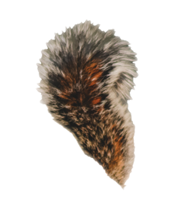

Utility – UltraPoleNXT Value Proposition
UltraPole NXT provides the electric utility with warrantied protection for its preferred support system, the wood pole, using an environmentally-advanced, lower toxicity wood protection system.
UltraPole NXT’s tested formulation provides long-term protection for the wood structure with a lower long-term regulatory burden, and little or no changes to current structure design. This protection is warrantied for 50 years, and at the end of its service life, the pole might be used to generate power rather than being a waste.
Oil-borne UltraPole NXT is a general-use pesticide
that has all the positive attributes of oil-borne preservatives
such as climbability.
The active ingredient in UltraPole NXT is safe enough for
decks that children play on, yet effective enough to replace
TBTO in anti-fouling formulations used on the hulls of ocean-going vessels.

Slide 17
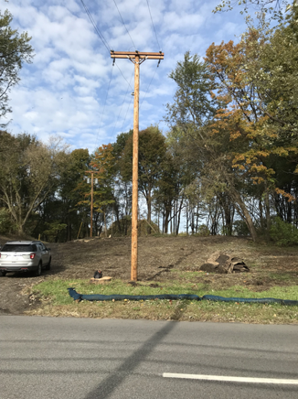
Utility Benefits
Usability
No design changes
No strength differences
No corrosion differences
No climbability differences
No conductivity differences
Non-Hygroscopic
Low odor
Similar:
  Appearance
  Handling
  Weight
Line workers will be handling material treated with a
non-restricted use pesticide.

Slide 18
Treater Benefits
Same treating equipment
Same Quality Assurance equipment
Similar oils
Oil carrier doesn’t need penta solvency
Similar treating process
Compatible with penta
Low solution corrosivity
DCOI waste is not considered an RCRA hazard waste under EPA Title 40 CFR 261.3.
Plant has less stringent EPA reporting.
Plant workers will not need a Certified Pesticide Applicators license to treat.
No strong odor to spark neighbor complaints.

Slide 19

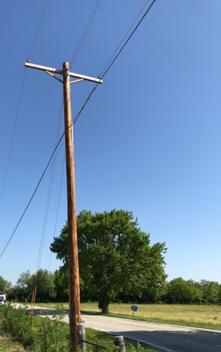
To Summarize
Effective – only warranted oil borne pole preservative
In all testing it performed very well compared to penta.
The active is used in all sorts of items in and around
the home.
Treaters can use the same equipment and processes.
Utilities will not see of feel a difference between DCOI
and penta poles.
DCOI poles are low odor – so don’t attract unwanted attention.
Unlikely that most people will notice it isn’t a penta pole.

Slide 20
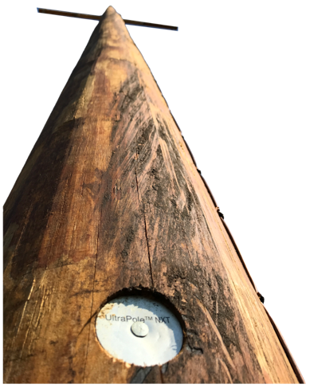


DCOI; Is it the best thing since ?
Well, we think so,
but maybe just the best thing since penta
I prefer, “the best thing since acorns grew on trees”.

Slide 21
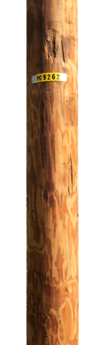
Companies That Have Announced They Will
Treat with DCOI
Brooks Manufacturing Co. – later this year
Hughes Brothers, Inc. – later this year or early next year
WC Meredith – has DCOI capability now – all DCOI by year’s end
Stella-Jones
  Pineville LA – has converted a cylinder to DCOI
  Arlington WA – has treated DCOI
3 or 4 more companies have indicated they will begin to treat with DCOI this summer

Slide 22
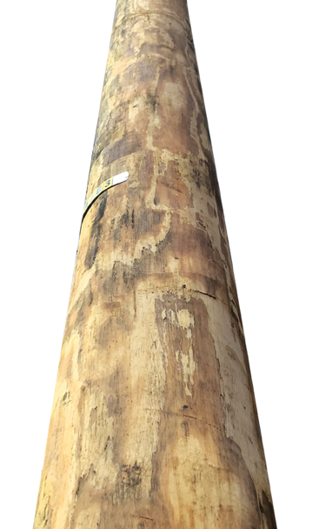
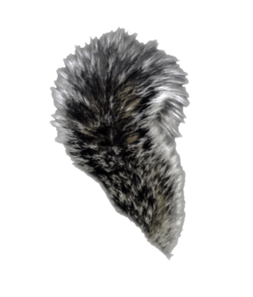

For More Information on DCOI
Type “UltraPole NXT” or
Go to https://www.treatedwood.com/
Or contact Bob Baeppler
  Email bbaeppler@viance.net
  Phone 704-497-0592
To be put on a mail list for monthly updates, contact Edie Kello
  Email ekello@viance.net
  Phone 704-905-4726

